Slide 1

CSSE332 Final Presentation
Jack Traversa, Noah Howard, Atli Arnarsson
SchizoThreads

Slide 2
Design Decisions
Stacks are managed by the user.
The user must malloc and provide sthread_create with a pointer to the malloced space.
The user must also free the pointer after they join a thread.
The stacks share the same memory space, meaning that they are already able to access each other’s stacks. Each thread has their own page table; mappings are copied over from the parent. growproc was modified to account for new page tables being added/removed.
For thread_combine (join), we modified wait() to look for a specific thread id and implemented reference counting.
For our thread_exit, we assign a return value to the thread (based on the argument), change its state to ZOMBIE, and remove it from our linked list before waking up the parent.
Notes:
Atli

Slide 3
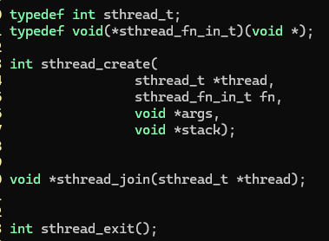

API Overview
Kernel Level
User Level
Notes:
Atli

Slide 4
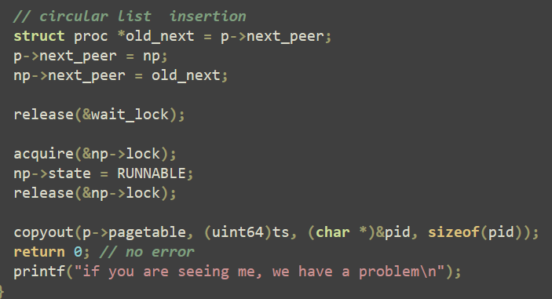
Lineage Management
We implemented a circular linked list for managing lineages
Still kept the parent/child structure
Notes:
Noah

Slide 5
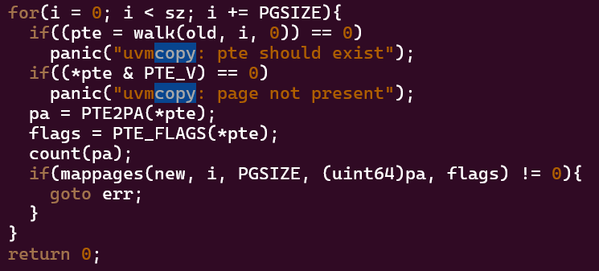
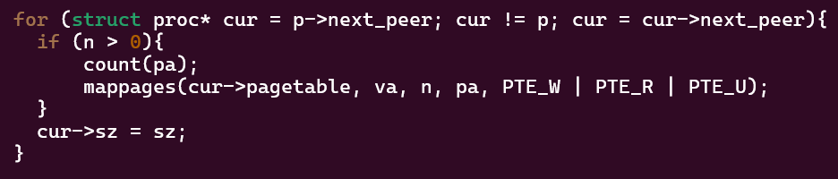
Shared Memory
Each thread has its own page table
Each of the thread’s page table entries points to a shared physical address between all threads
Synchronization is maintained through the linked list and growproc.
Whenever a new page table entry is added, all the threads in the same address space map to the physical address that the new one maps to.
Whenever a page table entry is removed, all the threads in the same address space also remove their entries that map to the same physical address.
Notes:
Jack

Slide 6
Challenges
Initially we were creating the stack at the kernel level which we realized was harder to implement than just having the user pass it in.
Getting deallocation to work for memory allocation took a while because we were calling uvmunmap() when we should have been calling uvmdealloc().
Knowing when to increment the reference counter.
Notes:
Jack

Slide 7
Changes We Would Make In Retrospect
We would have started with user provided stacks rather than planning for kernel provided stacks and then switching over.
We would’ve read through more xv6 source code before adding our own functions (specifically vm.c and proc.c) as we hadn’t looked at those since the COW lab.
Notes:
Noah

Slide 8
Questions?

